Slide 1
Car Number Plate Detection Using MATLAB and Image Processing
A.MOHAN KUMAR - PES2UG20CS002
ADITHYA MATHIALAGAN - PES2UG20CS019
AKSHAT BHANDARI - PES2UG20CS030
ANKUR KUMAR DUBEY - PES2UG20CS054

Slide 2
Abstract of the Project
Basically, video surveillance system is used for security purpose as well as monitoring systems. But Detection of moving object is a challenging part of video surveillance.
Accordingly, automated systems have been designed for numerous detection tasks, but the task of detecting illegally parked vehicles has been left largely to the human operators of surveillance systems.
This work proposes a method for the detection and identification of vehicle number plate that will help in the detection of number plates of authorized and unauthorized vehicles.
This approach is simplified to segment all the letters and numbers used in the number plate by using bounding box method. After segmentation of numbers and characters present on number plate, template matching approach is used for recognition of numbers and characters. The concentrate is given to locate the number plate region properly to segment all the number and letters to identify each number separately.

Slide 3
Aim of the project
To develop a system in MATLAB which can perform detection and recognition of Car Number Plate
The objective of this project is to recognize car number plate using serial communication

Slide 4
Methodology Used
In this system we will be working on CCTV footage or input image of a vehicle.
The CCTV footage must be clean and clear to extract the Vehicle number from the image taken as Input for the processing .
The following methods is used in this technology: -
Image capturing from camera
RGB to Gray scale
Detect license plate from image
Character segmentation from number plate
Character recognition
Display vehicle number

Slide 5
How it Works
Image processing is the process of transforming an image into a digital form and performing certain operations to get some useful information from it. The image processing system usually treats all images as 2D signals when applying certain predetermined signal processing methods.
The steps involved in image processing:
1. Importing the image via image acquisition tools
2. Analyzing and manipulating the image
3. Output in which result can be altered image or report that is based on image analysis.
Our system captures image of vehicle license plate and then the image is processed through multiple number of algorithms to provide an alpha numeric conversion of the image into a text format

Slide 6
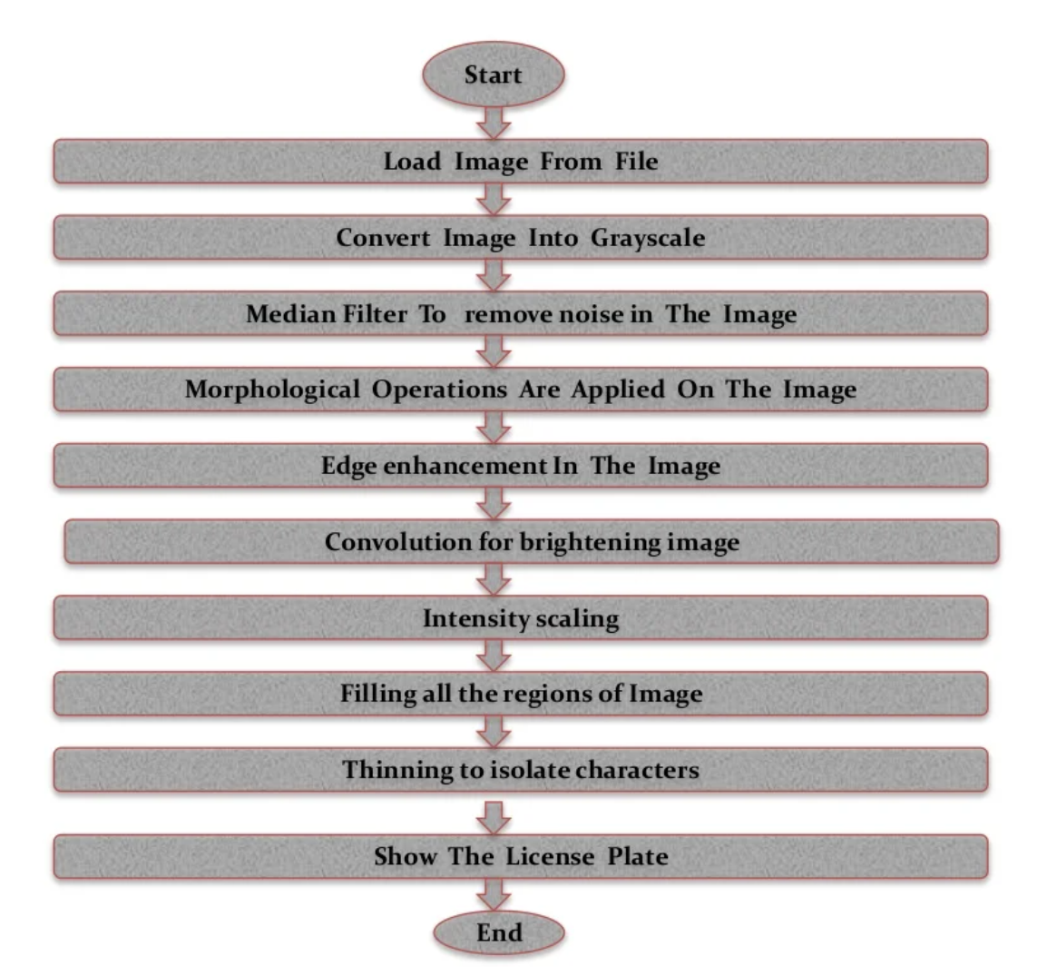
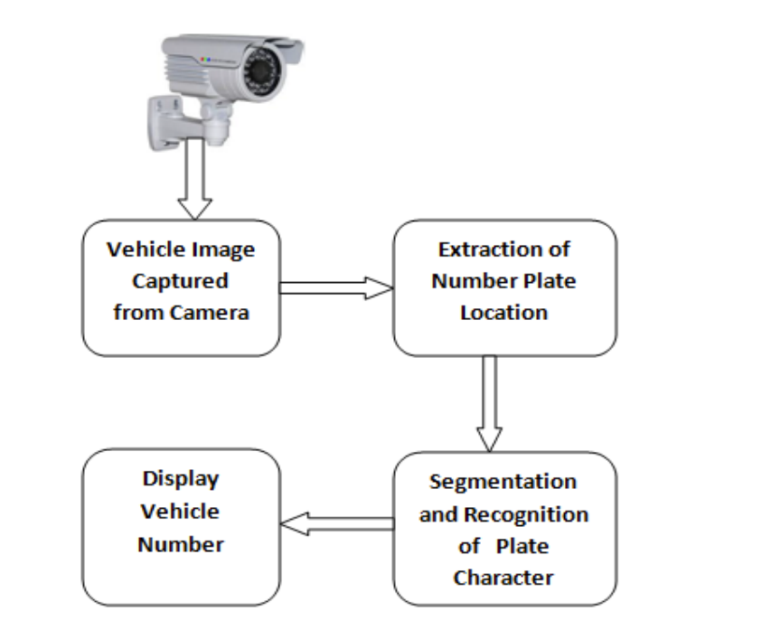
Flow Chart of Project

Slide 7
Overall Working of Project
We have used three files:
1. template_creation.m
2. Letter_detection.m
3. Plate_detection.m
In the template_creation.m file we have designed the code to save all the binary images of alphanumeric into a file named as ‘NewTemplates’.
In the Letter_detection.m file we match the letters of the input image with the images present in the file ‘NewTemplates’
In the Plate_detection.m file we process the input image and convert it to a binary image and detect its edges using Prewitt method. And then process the cropped license plate image and display the detected number in the image and text format

Slide 8
Template Creation (template_creation.m)
In this file we basically create a kind of database to store the letters and numbers so that it can be accessed later for the number plate detection.
Steps Involved:
1. Call the saved images of alphanumeric and then save them as a new template in MATLAB memory using : imread(image location)
2. Create an array to store all alphabets and create an array to store all numbers for detection.
3. Save the created arrays in a variable called ‘NewTemplates’ which can be used in other Codes.
All images present in the Folder Alpha are in binary format, in order to reduce space.

Slide 9
Letter Detection(Letter_detection.m)
Steps Involved:
1. We have created a function named ‘Letter’ which gives the alphanumeric output of the input image. Using command: readLetter(snap)
2. Resize the input image so that it can be compared with the template image created in ‘template_creation.m’ using: imresize()
3. Find the index which corresponds to the highest matched character using: find().
4. Then based on the index value we print the corresponding character using ‘if-else’ statements.

Slide 10
Number Plate Detection (Plate_detection.m)
Steps Involved:
Read input image from file using: imread()
Convert input image to grayscale format using: rgb2gray(image)
Convert the grayscale image to Binary format using-imbinarize (grayscaleImage)
Detect edges in the image using Prewitt method using- edge(image,’prewitt’)
Then find location of the number plate using:
regionprops(): Measures properties of image region
numel(): Calculate number of array elements
imcrop():Crop the image
bwareaopen(): remove unwanted small objects from image
6. Process the image and convert the detected number to image and text format

Slide 11
Application
Traffic control: It will be helpful in traffic control by telling intensity of vehicles in different areas.
Airport: It will be useful in airport parking to reduce frauds.
Tolling: It will be helpful at tolling poll to collect fine if vehicle found guilty.

Slide 12
The Difference of this Project from Taking Images.
Images taken by the camera would be of large size and storing thousands of image would waste a lot of time and memory space. So, we need such a system which can reduce complexity.
This project converts only number plate area(i.e useful information) into the digital text format. which takes size merely in kb. So, we can store a lot of record in such small space and also it would be easy to match records of the car using this digital information.

Slide 13
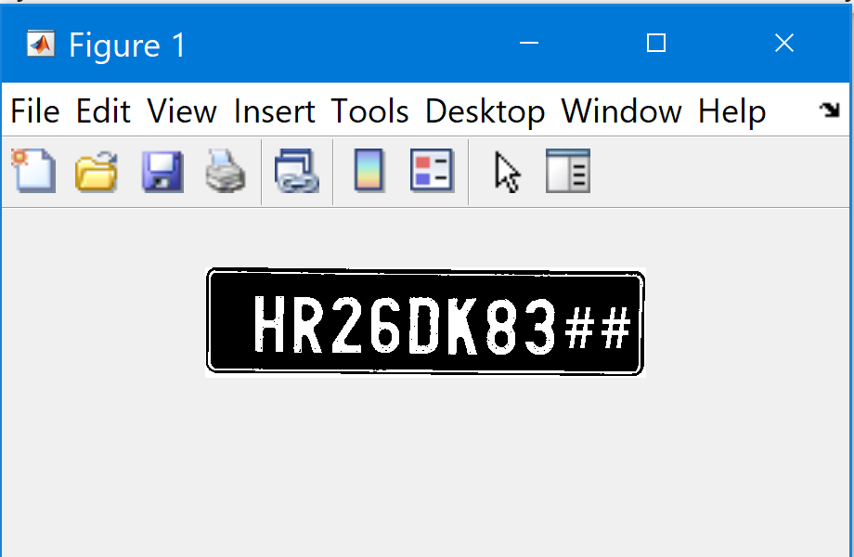
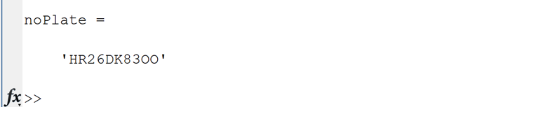
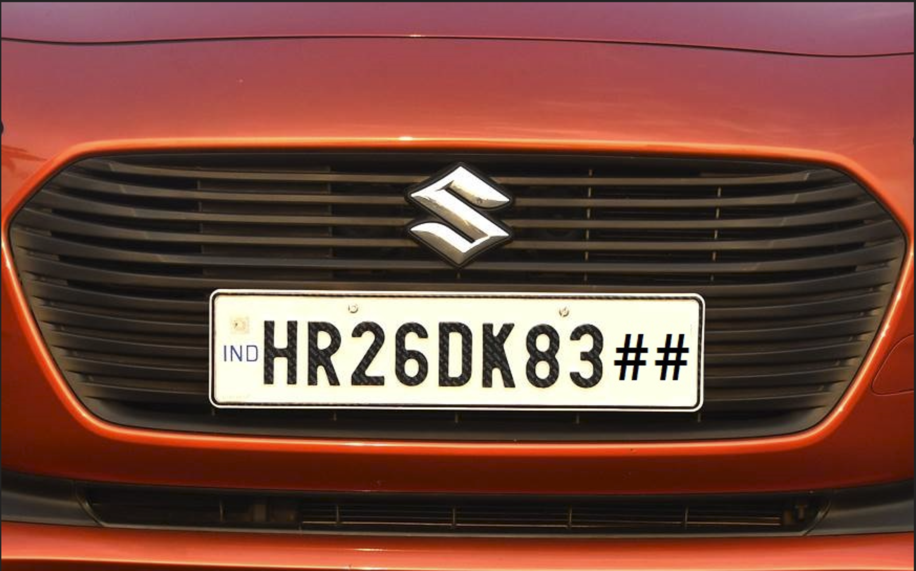
Output Screenshots

